Slide 1
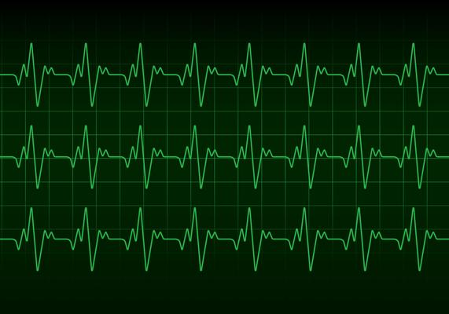
Transfer Learning for ECG Classification
Group 05

Slide 2
Group 05 - Members
Md Farhadul Islam
ID: 19201086
Dept. of CSE
Sarah Zabeen
ID: 19241004
Dept. of CSE

Slide 3
Paper Details:
Paper Title: Transfer learning for ECG classification
Authors: Kuba Weimann & Tim O. F. Conrad
Paper Link: Transfer learning for ECG classification | Scientific Reports (nature.com)
Publication Type: Journal Article - Nature Scientific Reports
Date Published: 04 March 2011

Slide 4
Abstract
Patients with periodic heart arrhythmia needs to be constantly monitored, for that reason automatic ECG interpretation can be very effective.
To solve the problem efficiently Authors use Deep CNN models.
However, training CNNs for ECG classification often requires a large number of annotated samples, which are expensive to acquire. In this work, they tackle this problem by using transfer learning.
First, they pretrain (both Supervised and Unsupervised) CNNs on the largest public data set of continuous raw ECG signals. Next, they finetune the networks on a small data set for classification of Atrial Fibrillation, which is the most common heart arrhythmia.
The pretraining improves the performance of CNNs on the target task by up to 6.57% effectively reducing the number of annotations required to achieve the same performance as CNNs that are not pretrained.

Slide 5
Introduction
ECG devices record large amounts of electrocardiogram (ECG) data that needs to be interpreted. This task falls on physicians, nurses and other medical workers. The additional workload further contributes to the fatigue regularly experienced by the medical staff at work, which increases the chances of medical errors [1,2].
A significant portion of the received ECG recordings are often false alarms, since the remote monitoring devices are very sensitive to abnormalities in the ECG, which prevents them from missing major cardiovascular events.
Therefore, the authors decided to automate this task using Deep CNNs.
Deep neural networks (DNN) have recently achieved cardiologist-level classification performance [4] when trained on a large (n = 91,232) data set of raw ECG recordings.
However, available ECG data sets are often much smaller, which makes it difficult to achieve a desirable performance level. This issue led them to focus on the case where the data set used for training a classifier is small.

Slide 6
Introduction
There are different approaches to improving classifiers when manual labeling becomes too expensive.
Two of them are: active learning & transfer learning
Active Learning: Active learning is the subset of machine learning in which a learning algorithm can query a user interactively to label data with the desired outputs. In active learning, the algorithm proactively selects the subset of examples to be labeled next from the pool of unlabeled data.
Transfer Learning: Transfer Learning is a machine learning method where they reuse a pre-trained model as the starting point for a model on a new task. To put it simply—a model trained on one task is repurposed on a second, related task as an optimization that allows rapid progress when modeling the second task.

Slide 7
Introduction
They use transfer learning to improve ECG classifiers.
First, they pretrain deep convolutional neural networks (CNN) on the Icentia11K [5] data set. To that end, they define several pretraining tasks that utilize either labeled or unlabeled data.
Next, they finetune the pretrained CNNs on the PhysioNet/CinC 2017 data set [7,8] to classify Atrial Fibrillation (AF). AF is the most common heart arrhythmia [7] characterized by an irregular heart rhythm that is caused by a chaotic propagation of electrical impulses in the atria.

Slide 8
Related Work (ECG Classification)
Most ECG classification methods for disease detection can be categorized as either heartbeat [13,14,15] or heart arrhythmia classification [4,16,17,18] based on some form of ECG signal as the input to a neural network.
Authors follow the trend of training 1d convolutional neural networks (CNN), in particular residual networks [21,22], on raw ECG signals for heart arrhythmia classification. In addition to that, they employ an attention model based on the Transformer architecture [23] for summarizing features from short ECG frames in one of the pretraining tasks.
Large ECG databases remain mostly inaccessible to the general public, thus a lot of research is done using relatively small public data sets, for example PhysioNet/CinC Challenge 2017 [7,8] data set, which is used for AF classification [4,20,26]. In this study, authors measure the performance of their pretraining methods on the PhysioNet/CinC Challenge 2017 data set.

Slide 9
Related Work (Transfer Learning)
There are studies [29,30] of transfer learning from 2-dimensional deep CNN features trained on ImageNet [6]. But, authors focus exclusively on transferable ECG representations, not transferable image representations.
Kachuee et al.[27] presented a method for ECG heartbeat classification based on transferable representations using 1-dimensional residual networks.
Strodthoff et al.[28] used transfer learning on public ECG data sets to classify heart arrhythmia.

Slide 10
Related Work (Representation/ Feature Learning)
Rahhal et al. [31] and Xia et al. [32] train stacked denoising autoencoders to reconstruct ECG heartbeats.
Tan et al. [5] reconstruct slightly longer ECG frames using a simple autoencoder, and Rajan et al. [33] train an encoder-decoder network composed of RNNs (also referred to as Seq2Seq model) to reconstruct missing channels from a short ECG frame.
In all of the above examples, the latent space learned by the generative model is exploited by training a classifier on top of it. However, generative models taught to reconstruct the input often fail to extract context information which may be useful for the downstream (target) task [34].

Slide 11
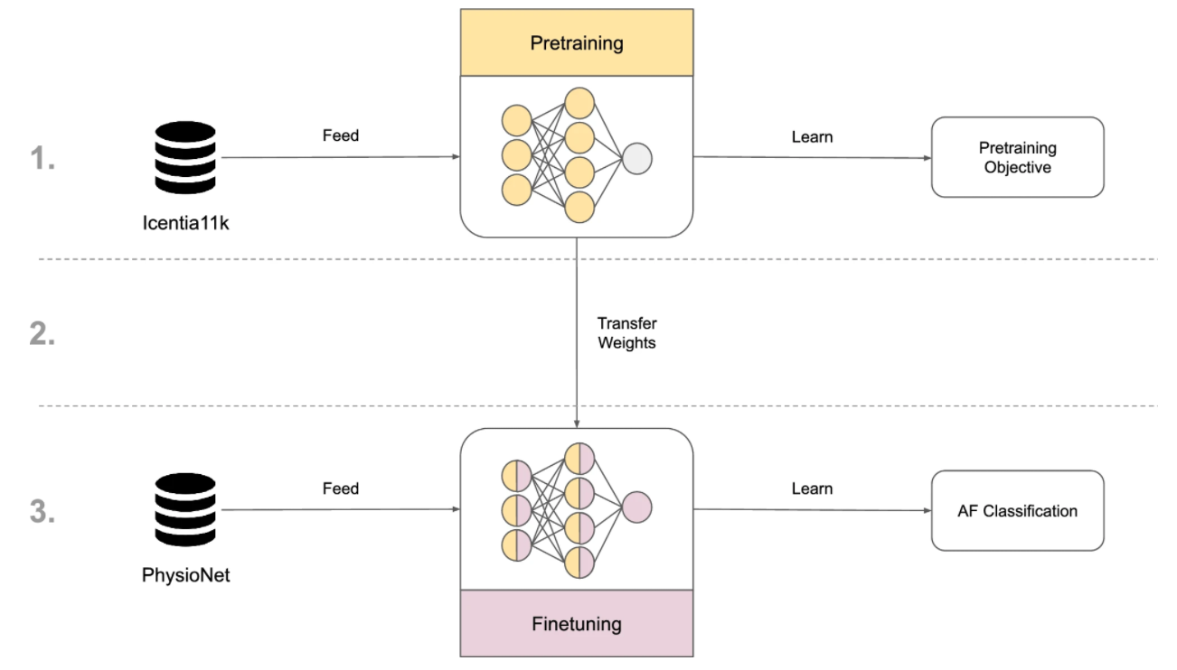
Method

Slide 12
Method (Pretraining)
They pretrain CNNs on Icentia11K, which contains ECG data from 11,000 patients. The average patient is about 60 years old and exhibits some form of heart arrhythmia.
The data set contains over 630,000 h of ECG signal with over 2,700,000,000 labeled beats.
During pretraining, they collect mini-batches by sampling short ECG frames from randomly chosen patients.
Once the pretraining is finished, they revert the model to the checkpoint, at which the model had the highest validation accuracy.

Slide 13
Method (Classification)
CNN predicts the presence of an abnormal beat in a short ECG frame. They look for the occurrence of either premature atrial contractions (PAC), premature ventricular contractions (PVC), or aberration. If no abnormality is found, the frame is labeled as normal beat. In rare cases of multiple abnormal beats within a single frame, they select the most frequent beat type for the label.
CNN predicts the heart rhythm from a short ECG frame. For each frame, they look at the duration of every rhythm to determine the label. Specifically, they pick the longest of the rhythms, while prioritizing Atrial Fibrillation (AFib) and Atrial Flutter (AFlut). This means that they first select the longer among AFib and AFlut if they are present, otherwise the longest of the remaining rhythms, i.e. normal sinus rhythm or noise.
In contrast to beat and rhythm classification, where labels are in part created by specialists, the labels for this task are generated automatically, i.e. without human intervention. For each frame, they first find the indices of heartbeats (this can be done using a QRS detection algorithm[35]) and estimate the number of beats per minute (BPM) based on the interbeat intervals. Next, they assign a class based on BPM: Bradycardia (< 60 BPM), Tachycardia (>100 BPM), Normal (60–100 BPM) and Noise in case of a failure to detect any heartbeats. Additionally, when generating the label, they always temporarily extend the size of the frame by 1 s at both ends.

Slide 14
Method (Classification)
CNN predicts the presence of an abnormal beat in a short ECG frame.
Classes: premature atrial contractions (PAC), premature ventricular contractions (PVC) & normal
CNN predicts the heart rhythm from a short ECG frame. For each frame, they look at the duration of every rhythm to determine the label. Specifically, they pick the longest of the rhythms, while prioritizing Atrial Fibrillation (AFib) and Atrial Flutter (AFlut). This means that they first select the longer among AFib and AFlut if they are present, otherwise the longest of the remaining rhythms, i.e. normal sinus rhythm or noise.
In contrast to beat and rhythm classification, where labels are in part created by specialists, the labels for this task are generated automatically, i.e. without human intervention. For each frame, they first find the indices of heartbeats (this can be done using a QRS detection algorithm[35]) and estimate the number of beats per minute (BPM) based on the interbeat intervals. Next, they assign a class based on BPM: Bradycardia (< 60 BPM), Tachycardia (>100 BPM), Normal (60–100 BPM) and Noise in case of a failure to detect any heartbeats. Additionally, when generating the label, they always temporarily extend the size of the frame by 1 s at both ends.

Slide 15
Method (Future Prediction)
The model predicts the future ECG signal based on a present ECG signal. This is a type of unsupervised representation learning, which is their adaptation of Contrastive Predictive Coding[34] to ECG data.
The future is an ECG frame collected at some distance from the context. The distance is measured in the number of frames that lie between the context and the future and they refer to it as the offset
Instead of predicting the future frame directly using a generative model, the context and the future are encoded into vector representations in a way that maximally preserves the mutual information between them.
By maximizing the mutual information, the model learns to extract the underlying latent variables, which are shared by the context and the future. This is achieved by optimizing a loss based on Noise Contrastive Estimation[36].

Slide 16
Method (Finetuning)
Before finetuning a CNN, they replace model’s output layer (i.e. classification layer) with a fully connected layer whose weights are randomly initialized and whose outputs match the classes of the PhysioNet/CinC Challenge 2017 data set. The CNNs are trained end-to-end (not freezing any pretrained weights) for up to 200 epochs. If the training accuracy does not improve for 50 epochs, the training is interrupted. Usually, the network achieves near 100% accuracy on the train set in a short time. As a consequence, the actual number of epochs is less than 200.
During finetuning, they record the macro F1 score, which is used as a metric in the PhysioNet/CinC Challenge 2017, on the validation set after each epoch. After the training is finished, they revert the weights of the network to the checkpoint at which the model had the highest macro F1 score on the validation set. Finally, authors record the macro F1 score achieved by the finetuned CNN on the test set.
In order to evaluate a pretraining method, they repeat the described finetuning procedure 10 times.

Slide 17
Method (Model Architecture)
They use ResNet-18v2[22] as the baseline CNN.
Their networks follow the design of the improved residual networks proposed by He et al.[22] with some small adjustments.
Due to the dimensionality of the input (i.e. ECG data is 1-dimensional), they replace the 2-dimensional convolutional layers with their 1-dimensional counterparts.
Furthermore, They use larger filter sizes, i.e. 7, 5, 5, and 3 at each stage respectively, which outperform the suggested smaller 3×3 filters.
The remaining architectural decisions and hyperparameters, including the weight initialization scheme, are the same as in He et al.[22].

Slide 18
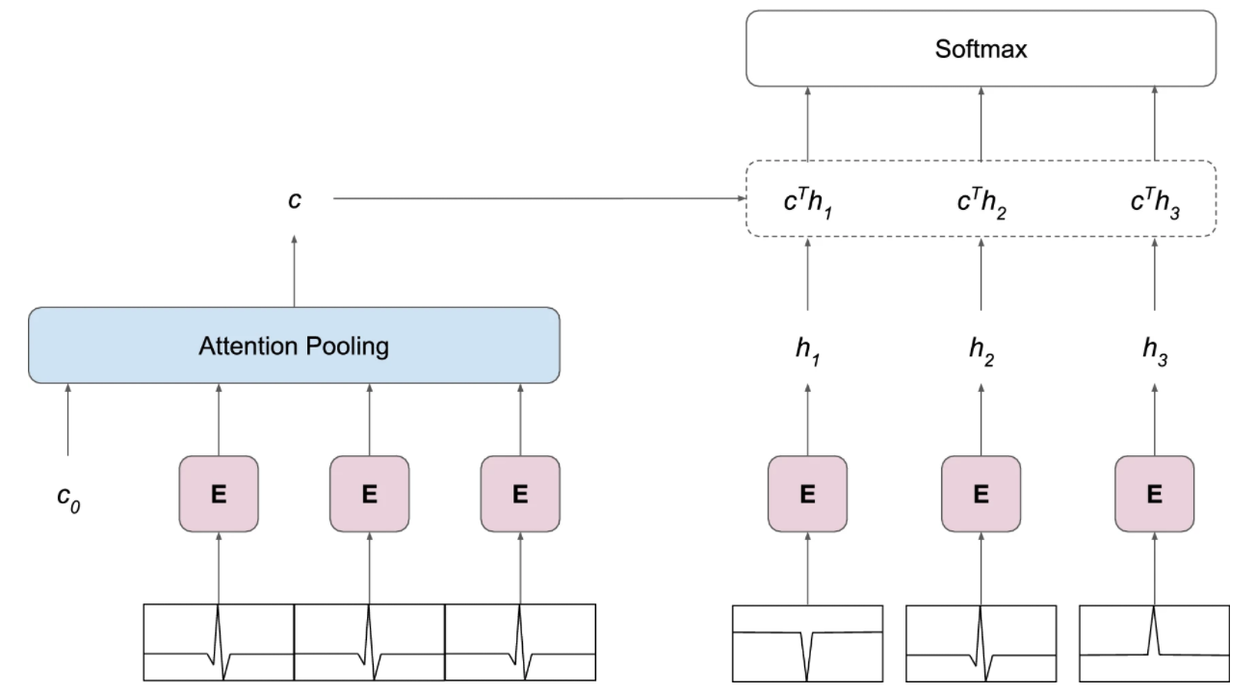
Method (Future Prediction Framework)
The framework for Contrastive Predictive Coding[34] consists of two models that are trained jointly: an encoder model that encodes the ECG frames and an autoregressive model that summarizes the encoded context frames into a single vector representation of the context.

Slide 19
Experiments & Results
Training:
Optimizer | Adam
Batch Size | Different batch sizes depending on the number of trainable parameters
Device | Nvidia Tesla P100 GPU

Slide 20
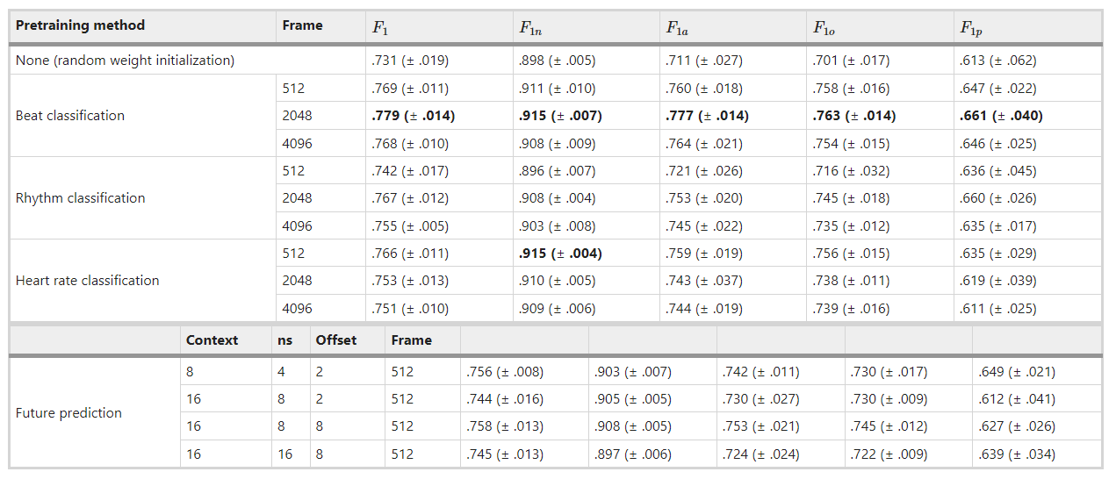
Experiments & Results
Hyperparameter Adjustment:

Slide 21
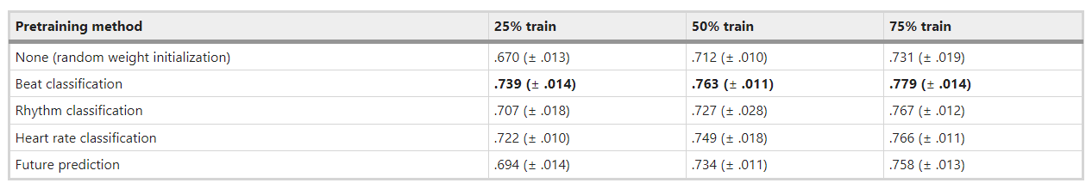
Experiments & Results
Results(F1 score) based on training samples:

Slide 22
Experiments & Results
ResNet-18v2, which is the baseline model which can be considered a “shallow” network.
ResNet-18v2 has a small number of layers and parameters comparatively.
Therefore, they increase the size of the model. They employ two new architectures: ResNet-34v2[22] and ResNet-50v2 [22], which replaces standard residual blocks with bottleneck blocks. Other hyperparameters of the network remain the same.

Slide 23
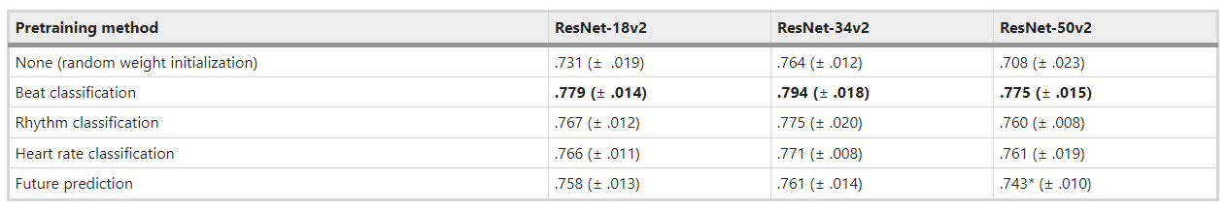
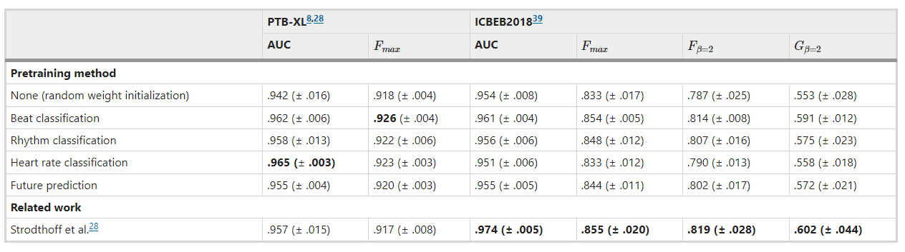
Comparison

Slide 24
Discussion
Transfer learning proves to be a valuable technique to deal with an inadequate amount of annotated data that plagues models trained to classify ECG recordings. In this work, they showed that pretraining convolutional neural networks (CNN) on a large ECG database and subsequently finetuning them on a much smaller ECG data set considerably improves the performance on the target task, effectively reducing the number of expensive annotations required to achieve the same performance level as CNNs that are not pretrained.

Slide 25
Advantages - Our Review
Helpful for tasks using small data
Their contribution is very strong
Pretraining CNNs improves the performance on the target task, i.e. AF classification, by up to 6.57%, effectively reducing the number of annotations required to achieve the same performance as CNNs that are not pretrained.

Slide 26
Limitations - Our Review
Other metrics would help to compare
Making the whole model uncertainty-aware would improve their decision makings

Slide 27
Conclusion

Slide 28
References
Tawfik, D. S. et al. Physician burnout, well-being, and work unit safety grades in relationship to reported medical errors. Mayo Clin. Proc. 93, 1571–1580 (2018)
West, C. P., Tan, A. D., Habermann, T. M., Sloan, J. A. & Shanafelt, T. D. Association of resident fatigue and distress with perceived medical errors. JAMA 302, 1294–1300. https://doi.org/10.1001/jama.2009.1389 (2009)
Schläpfer, J. & Wellens, H. J. Computer-interpreted electrocardiograms. J. Am. Coll. Cardiol. 70, 1183–1192. https://doi.org/10.1016/j.jacc.2017.07.723 (2017)
Hannun, A. Y. et al. Cardiologist-level arrhythmia detection and classification in ambulatory electrocardiograms using a deep neural network. Nat. Med. 25, 65–69. https://doi.org/10.1038/s41591-018-0268-3 (2019 .
Tan, S. et al. Icentia11K: An Unsupervised Representation Learning Dataset for Arrhythmia Subtype Discovery (2019). arXiv:arXiv:1910.09570
Deng, J. et al. ImageNet: A large-scale hierarchical image database. in CVPR09 (2009)
Clifford, G. D. et al. AF Classification from a short single lead ECG recording: the PhysioNet/computing in cardiology challenge 2017. Comput. Cardiol. (2017)
Goldberger, A. L. et al. PhysioBank, PhysioToolkit, and PhysioNet: components of a new research resource for complex physiologic signals. Circulation 101, e215–e220. https://doi.org/10.1161/01.CIR.101.23.e215 (2000)
He, K., Fan, H., Wu, Y., Xie, S., & Girshick, R. Momentum Contrast for Unsupervised Visual Representation Learning (2020). arXiv:1911.05722.
Grill, J.-B. et al. Bootstrap Your Own Latent: A New Approach to Self-Supervised Learning (2020). arXiv:2006.07733
Faust, O., Hagiwara, Y., Hong, T. J., Lih, O. S. & Acharya, U. R. Deep learning for healthcare applications based on physiological signals: a review. Comput. Methods Prog. Biomed. 161, 1–13. https://doi.org/10.1016/j.cmpb.2018.04.005 (2018)
Hong, S., Zhou, Y., Shang, J., Xiao, C., & Sun, J. Opportunities and Challenges of Deep Learning Methods for Electrocardiogram Data: A Systematic Review (2020). arXiv:2001.01550
Acharya, U. R. et al. Application of deep convolutional neural network for automated detection of myocardial infarction using ecg signals. Inf. Sci. 415–416, 190–198. https://doi.org/10.1016/j.ins.2017.06.027 (2017)
Jun, T. J. et al. ECG Arrhythmia Classification Using a 2-D Convolutional Neural Network (2018). arXiv:1804.06812
Mousavi, S., Afghah, F. & Acharya, U. R. Inter- and Intra-Patient ECG Heartbeat Classification for Arrhythmia Detection: A Sequence to Sequence Deep Learning Approach (2019). arXiv:1812.07421
Attia, Z. I. et al. An artificial intelligence-enabled ECG algorithm for the identification of patients with atrial fibrillation during sinus rhythm: a retrospective analysis of outcome prediction. Lancet 394, 861–867. https://doi.org/10.1016/s0140-6736(19)31721-0 (2019)
Rajpurkar, P., Hannun, A. Y., Haghpanahi, M., Bourn, C., & Ng, A. Y. Cardiologist-Level Arrhythmia Detection with Convolutional Neural Networks (2017). arXiv:1707.01836
Ribeiro, A. H. et al. Automatic Diagnosis of the 12-Lead ECG Using a Deep Neural Network (2019). arXiv:1904.01949
Mousavi, S., Afghah, F., Razi, A., & Acharya, U. R. ECGNET: Learning where to attend for detection of atrial fibrillation with deep visual attention (2019). arXiv:1812.07422
Zihlmann, M., Perekrestenko, D., & Tschannen, M. Convolutional Recurrent Neural Networks for Electrocardiogram Classification (2018). arXiv:1710.06122

Slide 29
References
21. He, K., Zhang, X., Ren, S., & Sun, J. Deep Residual Learning for Image Recognition (2015). arXiv:1512.03385
22. He, K., Zhang, X., Ren, S., & Sun, J. Identity Mappings in Deep Residual Networks (2016). arXiv:1603.05027
23. Vaswani, A. et al. Attention Is All You Need (2017). arXiv:1706.03762
24. Bahdanau, D., Cho, K., & Bengio, Y. Neural Machine Translation by Jointly Learning to Align and Translate (2016). arXiv:1409.0473
25. Xu, K. et al. Show, Attend and Tell: Neural Image Caption Generation with Visual Attention (2016). arXiv:1502.03044
26. Xiong, Z. et al. ECG signal classification for the detection of cardiac arrhythmias using a convolutional recurrent neural network. Physiol. Meas. 39, 094006 (2018)
27. Kachuee, M., Fazeli, S., & Sarrafzadeh, M. ECG heartbeat classification: a deep transferable representation. in 2018 IEEE International Conference on Healthcare
Informatics (ICHI)https://doi.org/10.1109/ichi.2018.00092 (2018)
28. Strodthoff, N., Wagner, P., Schaeffter, T., & Samek, W. Deep Learning for ECG Analysis: Benchmarks and Insights from PTB-XL (2020). arXiv:2004.13701
29. Salem, M., Taheri, S., & Shiun-Yuan, J. ECG Arrhythmia Classification Using Transfer Learning from 2-Dimensional Deep CNN Features (2018). arXiv:1812.04693
30. Wu, Y., Yang, F., Liu, Y., Zha, X., & Yuan, S. A Comparison of 1-D and 2-D Deep Convolutional Neural Networks in ECG Classification (2018). arXiv:1810.07088
31. Rahhal, M. A. et al. Deep learning approach for active classification of electrocardiogram signals. Inf. Sci. 345, 340–354. https://doi.org/10.1016/j.ins.2016.01.082
(2016)
32. Xia, Y. et al. An automatic cardiac arrhythmia classification system with wearable electrocardiogram. IEEE Access 6, 16529–16538 (2018)
33. Rajan, D., Beymer, D., & Narayan, G. Generalization Studies of Neural Network Models for Cardiac Disease Detection Using Limited Channel ECG (2019).
arXiv:1901.03295
34. van den Oord, A., Li, Y., & Vinyals, O. Representation Learning with Contrastive Predictive Coding (2019). arXiv:1807.03748
35. Pan, J. & Tompkins, W. J. A Real-Time QRS Detection Algorithm. IEEE Trans. Biomed. Eng. 32, 230–236 (1985)
36. Gutmann, M., & Hyvärinen, A. Noise-contrastive estimation: a new estimation principle for unnormalized statistical models. in Teh, Y. W. & Titterington, M. (eds.)
Proceedings of the Thirteenth International Conference on Artificial Intelligence and Statistics, vol. 9 of Proceedings of Machine Learning Research, 297–304
(PMLR, Chia Laguna Resort, Sardinia, Italy, 2010)
37. Trinh, T. H., Luong, M.-T., & Le, Q. V. Selfie: Self-Supervised Pretraining for Image Embedding (2019). arXiv:1906.02940
38. Kingma, D. P., & Ba, J. A Method for Stochastic Optimization (Adam, 2017). arXiv:1412.6980
39. Liu, F. et al. An open access database for evaluating the algorithms of electrocardiogram rhythm and morphology abnormality detection. J. Med. Imaging Health Inf.
8, 1368–1373. https://doi.org/10.1166/jmihi.2018.2442 (2018)
40. Perez Alday, E. A. et al. Classification of 12-lead ECGs: The PhysioNet—Computing in Cardiology Challenge. https://doi.org/10.13026/F4AB-0814 (2020)
.

